Slide 1
LLM working
Dr. Rakhee Chhibber

Slide 2
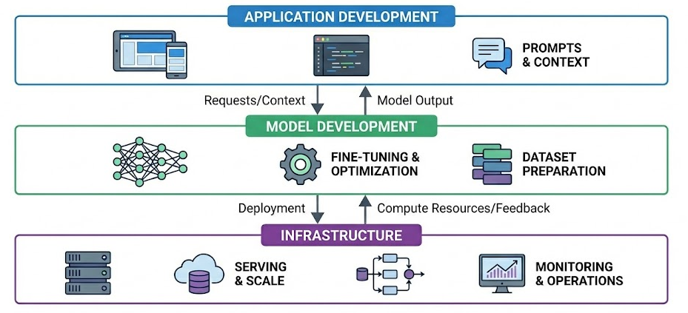

Slide 3
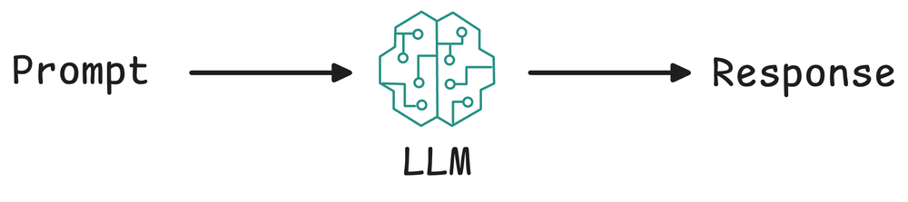

Slide 4
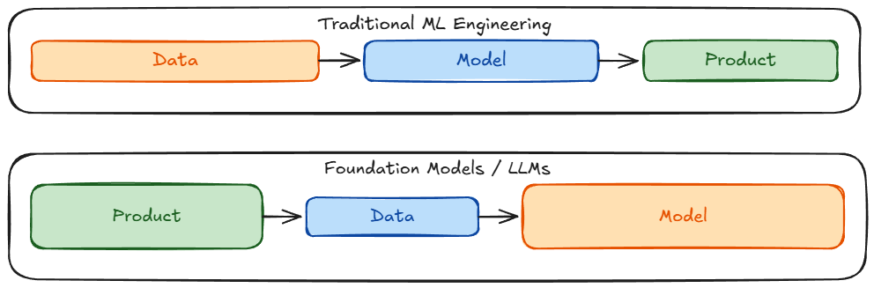

Slide 5
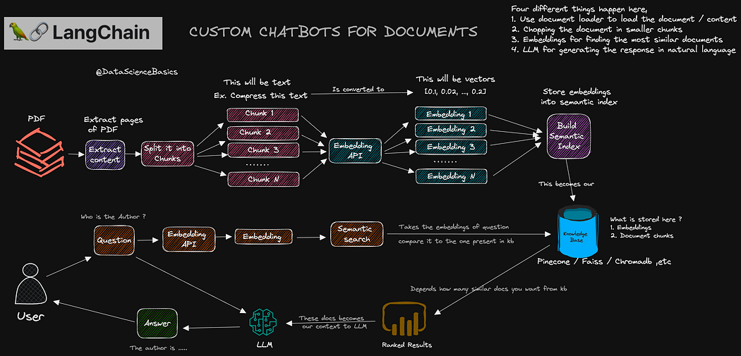

Slide 6
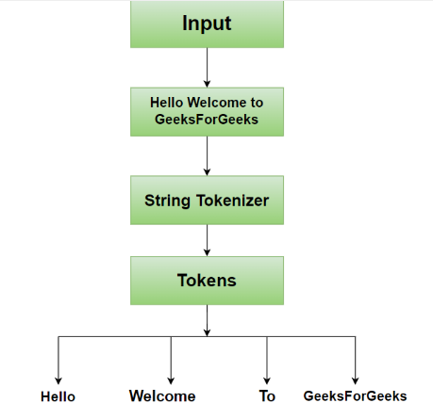
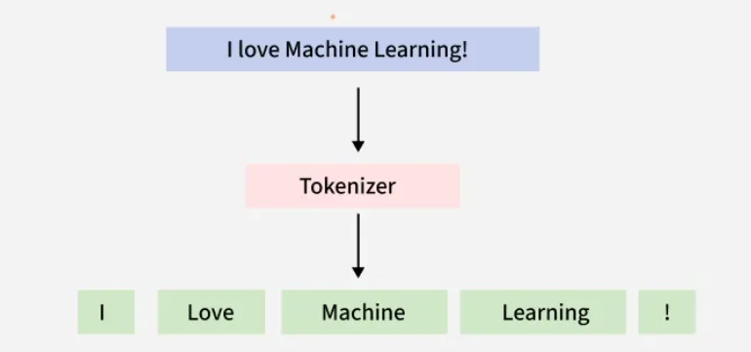
Tokenization

Slide 7
Tokenization Technique
Whitespace tokenization
Statistical tokenization
Rule Based Tokenization
Transformer based tokenization
Byte pair Encoding(BPE)

Slide 8
WhitespaceTokenizer/ Word Tokenizer
Splits text on any whitespace character
Handles multiple consecutive whitespace characters gracefully
Provides span information for token positions
Integrates with NLTK's broader text processing pipeline
Follows consistent tokenizer interface patterns

Slide 9
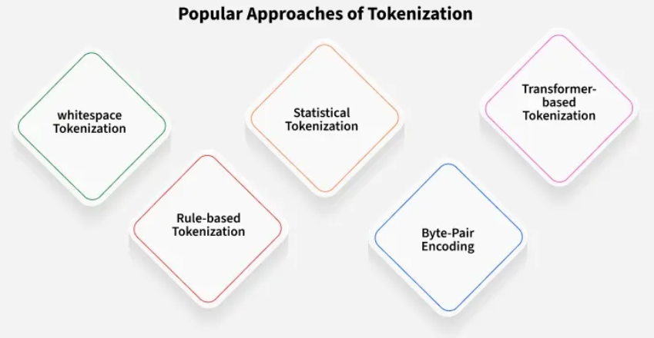
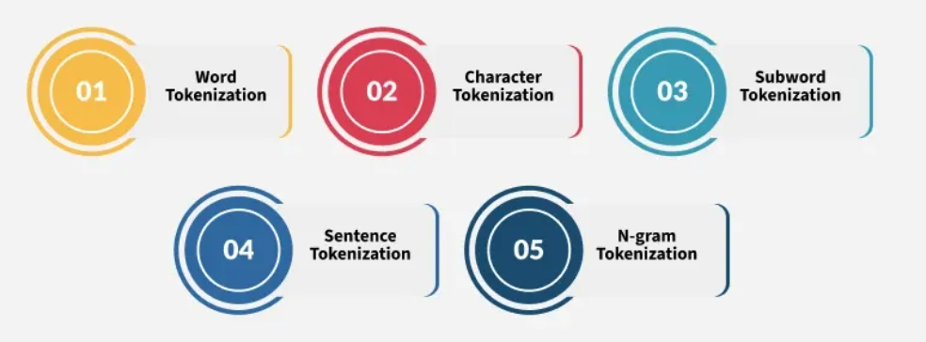

Slide 10
Word Embedding -https://huggingface.co/spaces/hesamation/primer-llm-embedding?section=word2vec
Processing text for NLP tasks requires a numeric representation of each word. Most embedding methods come down to turning a word or token into a vector. What makes embedding techniques different from each other, is how they approach this word → vector conversion.
Embedding is not just for text, they can be applied to images, audio, or even graph data. In a general sense, embedding is the process of converting data [of any type] into vectors.

Slide 11
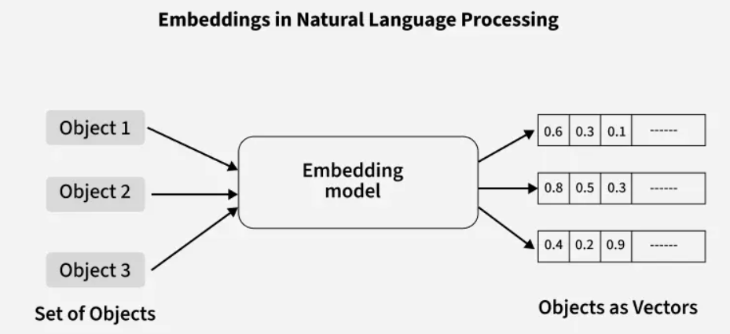

Slide 12
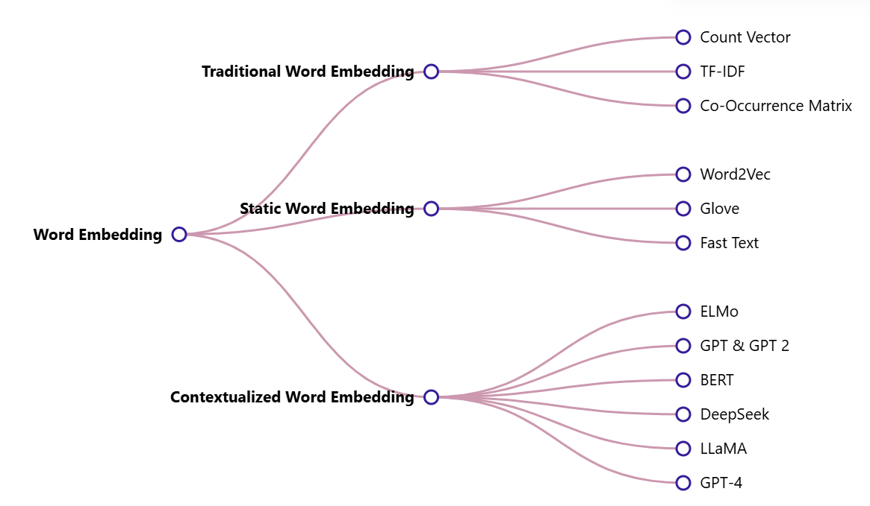

Slide 13
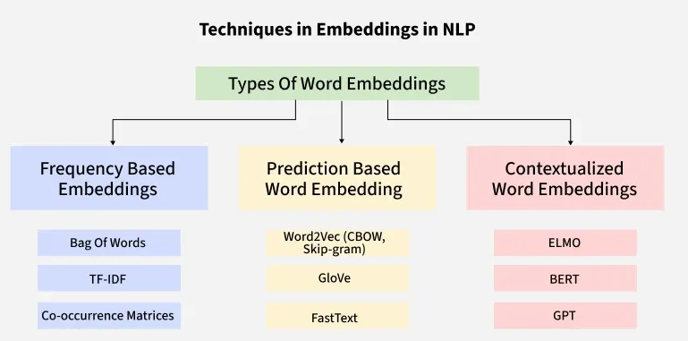

Slide 14
1. Traditional Approach/Frequency based
One-Hot Encoding
Bag of Word (Bow)
Term frequency-inverse document frequency (TF-IDF)

Slide 15
One-Hot Encoding
One-hot encoding is a simple method for representing words in natural language processing (NLP). In this encoding scheme, each word in the vocabulary is represented as a unique vector, where the dimensionality of the vector is equal to the size of the vocabulary. The vector has all elements set to 0, except for the element corresponding to the index of the word in the vocabulary, which is set to 1.
Following are the disadvantages:
  High-dimensional vectors, Computationally expensive and Memory-intensive
  Does not capture Semantic Relationships
  Restricted to the seen training vocabulary

Slide 16
Bag of Word (Bow)
Bag-of-Words (BoW) is a text representation technique that represents a document as an unordered set of words and their respective frequencies. It discards the word order and captures the frequency of each word in the document, creating a vector representation. Limitations are as follows:
  Ignores the order of words in the document: Causes loss of sequential information and context
  Sparse representations make it Memory intensive: Many elements are zero resulting in Computational inefficiency with large datasets.

Slide 17
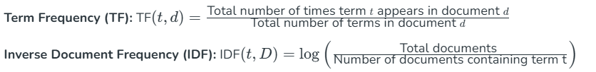
Term frequency-inverse document frequency (TF-IDF)
Term Frequency-Inverse Document Frequency, commonly known as TF-IDF, is a numerical statistic that reflects the importance of a word in a document relative to a collection of documents (corpus). It is widely used in natural language processing and information retrieval to evaluate the significance of a term within a specific document in a larger corpus. TF-IDF consists of two components:
Term Frequency (TF): Measures how often a term (word) appears in a document.
Inverse Document Frequency (IDF): Measures the importance of a term across a collection of documents.

Slide 18
Process
Define a set of sample documents.
Use TfidfVectorizer to transform these documents into a TF-IDF matrix.
Extract and print the TF-IDF values for each word in each document.
This statistical measure helps assess the importance of words in a document relative to their frequency across a collection of documents,
Helps in information retrieval and text analysis tasks.
https://colab.research.google.com/drive/1JKYa3mJ2SduiBTWUieXo2JmSyvt-eVo9?authuser=2#scrollTo=dT4imvWEtpUn

Slide 19
Neural Approach/Static Word /Prediction Based Embeddings
Word2Vec
Continuous Bag of Words(CBOW)
Skip-Gram

Slide 20
Word2Vec
Word2Vec is a neural approach for generating word embeddings. It belongs to the family of neural word embedding techniques and specifically falls under the category of distributed representation models. It is a popular technique in natural language processing (NLP).
Represent words as continuous vector spaces.
Aim: Capture the semantic relationships between words by mapping them to high-dimensional vectors.
Words with similar meanings should have similar vector representations. Every word is assigned a vector. We start with either a random or one-hot vector.
There are two neural embedding methods for Word2Vec: Continuous Bag of Words (CBOW) and Skip-gram.

Slide 21
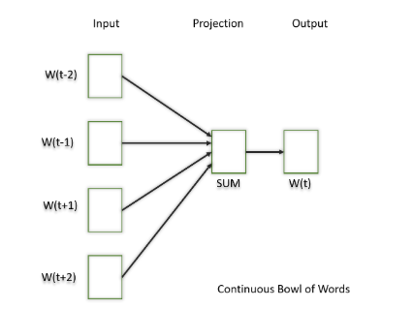
Continuous Bag of Words(CBOW)
Continuous Bag of Words (CBOW) is a type of neural network architecture used in the Word2Vec model. The primary objective of CBOW is to predict a target word based on its context, which consists of the surrounding words in a given window. Given a sequence of words in a context window, the model is trained to predict the target word at the center of the window.
  Feedforward neural network with a single hidden layer.
  The input layer, hidden layer, and output layer represent the context words, learned continuous vectors or embeddings, and the target word.
  Useful for learning distributed representations of words in a continuous vector space.
The hidden layer contains the continuous vector representations (word embeddings) of the input words.
  The weights between the input layer and the hidden layer are learned during training.
  The dimensionality of the hidden layer represents the size of the word embeddings (the continuous vector space).

Slide 22
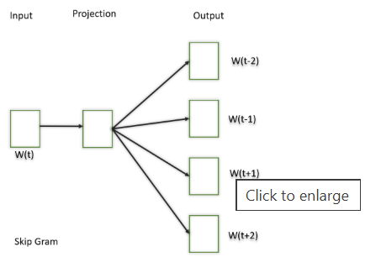
Skip-Gram
This model learns distributed representations of words in a continuous vector space. The main objective of Skip-Gram is to predict context words (words surrounding a target word) given a target word. This is the opposite of the Continuous Bag of Words (CBOW) model, where the objective is to predict the target word based on its context. It is shown that this method produces more meaningful embeddings.
Output: Trained vectors of each word after many iterations through the corpus.
Preserve syntactical or semantic information, Converted to lower dimensions.
Similar meaning (semantic info) vectors are placed close to each other in space.
vector_size parameter controls the dimensionality of the word vectors, and you can adjust other parameters such as window.

Slide 23
CBOW or Skip-gram
The choice between CBOW and Skip-gram depends on data and the task.
CBOW might be preferred when training resources are limited, and capturing syntactic information is important.
Skip-gram is chosen when semantic relationships and the representation of rare words are important.
https://colab.research.google.com/drive/1LdSp6KokBuYf23otD0ZcLYUVKTakvGjS?authuser=2#scrollTo=XOFR27vFwMHA

Slide 24
Pre-trained / Contextualized Word Embeddings
Pre-trained word embeddings are representations of words that are learned from large corpora and are made available for reuse in various Natural Language Processing (NLP) tasks. These embeddings capture semantic relationships between words, allowing the model to understand similarities and relationships between different words in a meaningful way.
GloVe
Fast
BERT (Bidirectional Encoder Representations from Transformers) text

Slide 25
GloVe
GloVe is trained on global word co-occurrence statistics. It leverages the global context to create word embeddings that reflect the overall meaning of words based on their co-occurrence probabilities. this method, we take the corpus and iterate through it and get the co-occurrence of each word with other words in the corpus. We get a co-occurrence matrix through this. The words which occur next to each other get a value of 1, if they are one word apart then 1/2, if two words apart then 1/3 and so on.
Let's see how the matrix is created. Corpus:
It is a nice evening.
Good Evening!
Is it a nice evening?

Slide 26
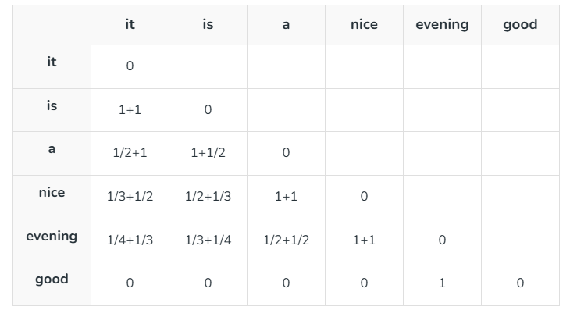
Example
The upper half of the matrix will be a reflection of the lower half. We can consider a window frame as well to calculate the co-occurrences by shifting the frame till the end of the corpus. This helps gather information about the context in which the word is used.
  Vectors for each word is assigned randomly.
  Take two pairs of vectors and see closeness in space.
  If they occur together more often or have a higher value in the co-occurrence matrix and are far apart in space then they are brought close to each other.
  If they are close to each other but are rarely or not frequently used together then they are moved further apart in space.
  Output: Vector space representation that approximates the information from the co-occurrence matrix.

Slide 27
Fasttext
Developed by Facebook, FastText extends Word2Vec by representing words as bags of character n-grams. This approach is particularly useful for handling out-of-vocabulary words and capturing morphological variations.

Slide 28
BERT (Bidirectional Encoder Representations from Transformers)
BERT is a transformer-based model that learns contextualized embeddings for words. It considers the entire context of a word by considering both left and right contexts, resulting in embeddings that capture rich contextual information.
https://colab.research.google.com/drive/1YP3Nhhp0MKS1CauO6p0ayKpmYjLNfYRQ?authuser=2#scrollTo=3hlZ5dfnziUp

Slide 29
Exmaple How LLM works

Slide 30
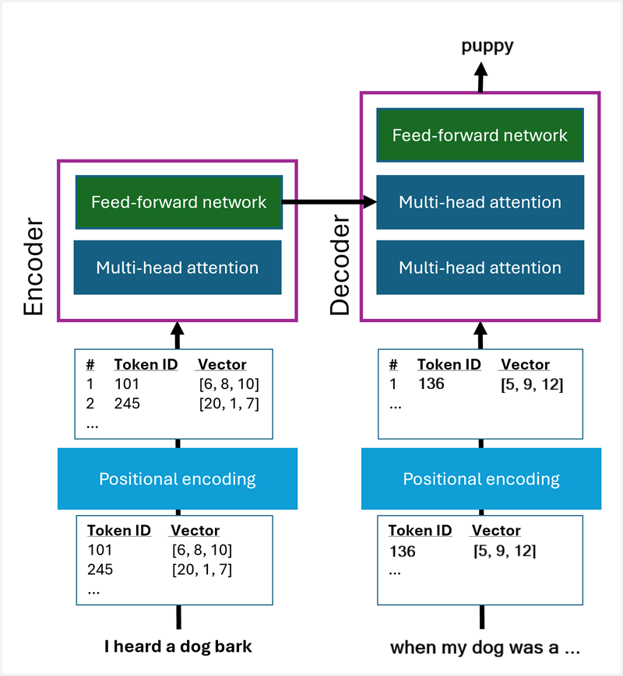

Slide 31
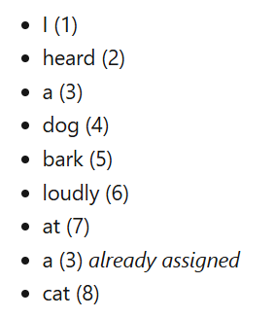
Example
I heard a dog bark loudly at a cat
Tokenization

Slide 32
Initial vectors and positional encoding
Initially, the token vector values are assigned randomly, before being fed through the transformer to create embedding vectors. The token vectors are fed into the transformer along with a positional encoding that indicates where the token appears in the sequence of training text (we need to do this because the order in which tokens appear in the sequence is relevant to how they relate to one another). For example, our tokens might start off looking like this:

Slide 33
Token | Token ID | Position | Vector
I | 1 | 1 | [3, 7, 10]
heard | 2 | 2 | [2, 15, 1]
a | 3 | 3 | [9, 11, 1]
dog | 4 | 4 | [2, 7, 11]
bark | 5 | 5 | [9, 12, 0]
loudly | 6 | 6 | [3, 8, 13]
at | 7 | 7 | [5, 7, 10]
a | 3 | 8 | [9, 11, 1]
cat | 8 | 9 | [8, -6, 9 ]
... | ... | ... | ...
puppy | 127 | 45 | [7, 7, -2 ]
car | 128 | 56 | [5, -5, 1 ]
skateboard | 129 | 67 | [4, 7, 14]

Slide 34
Token | Token ID | Embedding
I | 1 | [2, 0, -1 ]
heard | 2 | [-2, 2, 4 ]
a | 3 | [-3, 5, 5 ]
dog | 4 | [10, 3, 2 ]
bark | 5 | [9, 2, 10 ]
loudly | 6 | [-3, 8, 3 ]
at | 7 | [-5, -1, 1]
cat | 8 | [10, 3, 1]
puppy | 127 | [5, 3, 2 ]
car | 128 | [-2, -2, 1 ]
skateboard | 129 | [-3, -2, 2 ]
bark | 203 | [2, -2, 3 ]

Slide 35
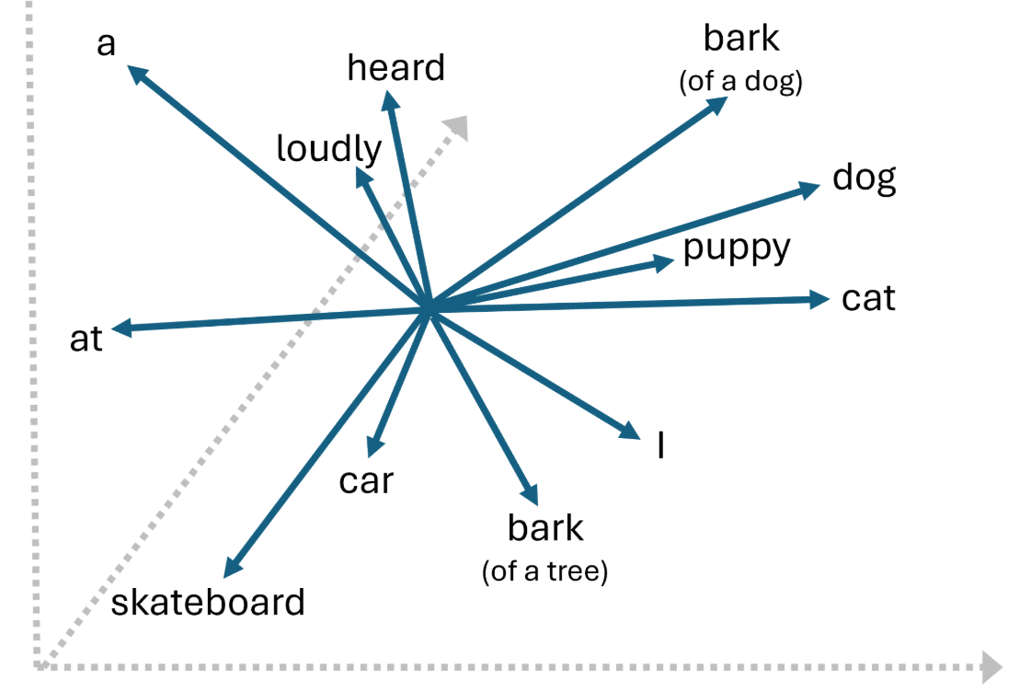
Because the dimensions are calculated based on how the tokens relate linguistically to one another, tokens that are used in similar contexts (and therefore have similar meanings) result in vectors with similar directions. For example, the embeddings for "dog" and "puppy" point in more or less the same direction, which isn't too different from the embedding for "cat"; but very different from the embedding for "skateboard" or "car". We can measure how close tokens are to one another semantically by calculating the cosine similarity of their vectors.

Slide 36
Storing Embedding to Similarity Index

Slide 37
Semantic Indexing
Building a "semantic index" within a Transformer model using positional encoding is a process of fusing semantic information (what a word means) with positional information (where a word is in a sequence) in the input embeddings

Slide 38
Steps
Generate Token Embeddings
Compute Positional Encodings (PE)
Combine Embeddings and Positional Encodings
  Input representation = token embeddings + positional Embeddings
Process with Transformer Layers
  The combined representations are fed into the subsequent layers of the Transformer, starting with the multi-head self-attention mechanism.
Build the Semantic Index
Within the self-attention layers, the model understand the relationships between words based on their relative positions (e.g., in "The cat sat on the mat", the model understands that "cat" is the subject and "mat" is the object because of their positions).
Create a rich, context-aware representation, which can be thought of as a semantic index that captures the full meaning and structure of the input sequence.

Slide 39
Vector Databases

Slide 40
Introduction
Vector databases enable efficient storage and searching of vector data. They are essential for developing and maintaining AI applications using large language models (LLMs).
Vector databases are specialized systems designed to store, manage, and query high-dimensional vector embeddings. These embeddings are numerical representations of data — such as text, images, or audio — that capture semantic meaning. Unlike traditional databases that store raw text or numbers, vector databases handle these high-dimensional vectors efficiently, allowing for fast and accurate similarity searches.

Slide 41
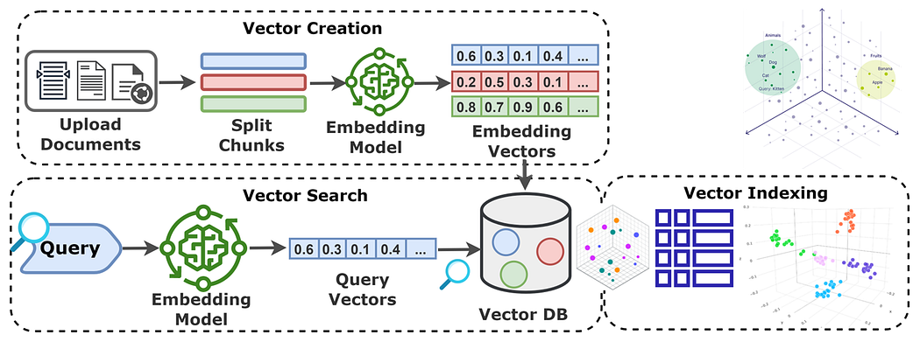

Slide 42
Why are Vector Databases important?
Semantic Understanding: They enable applications to understand the context and meaning behind data.
Efficient Retrieval: Optimized for handling high-dimensional data, making searches quick even with large datasets.
AI Integration: Essential for AI applications that rely on understanding and processing complex data relationships.

